Slide 1
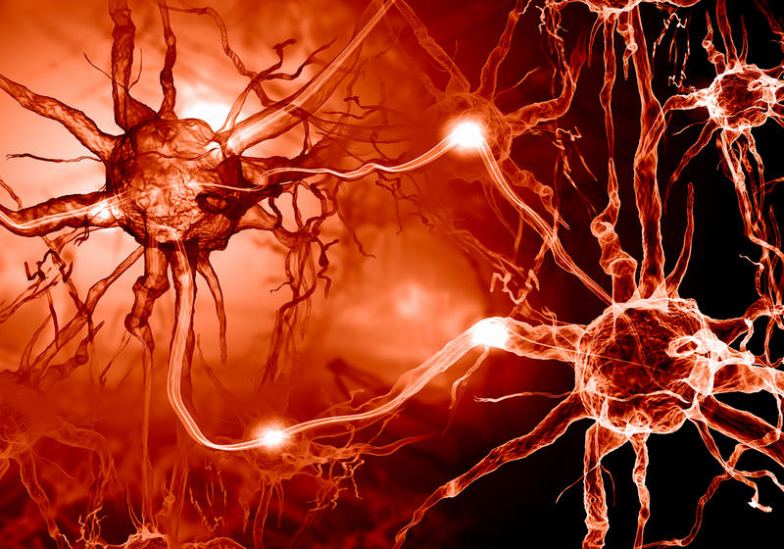

Year 12 Human Biology
Mr. Yates
2022

Slide 3
Students will be able to:

Slide 4
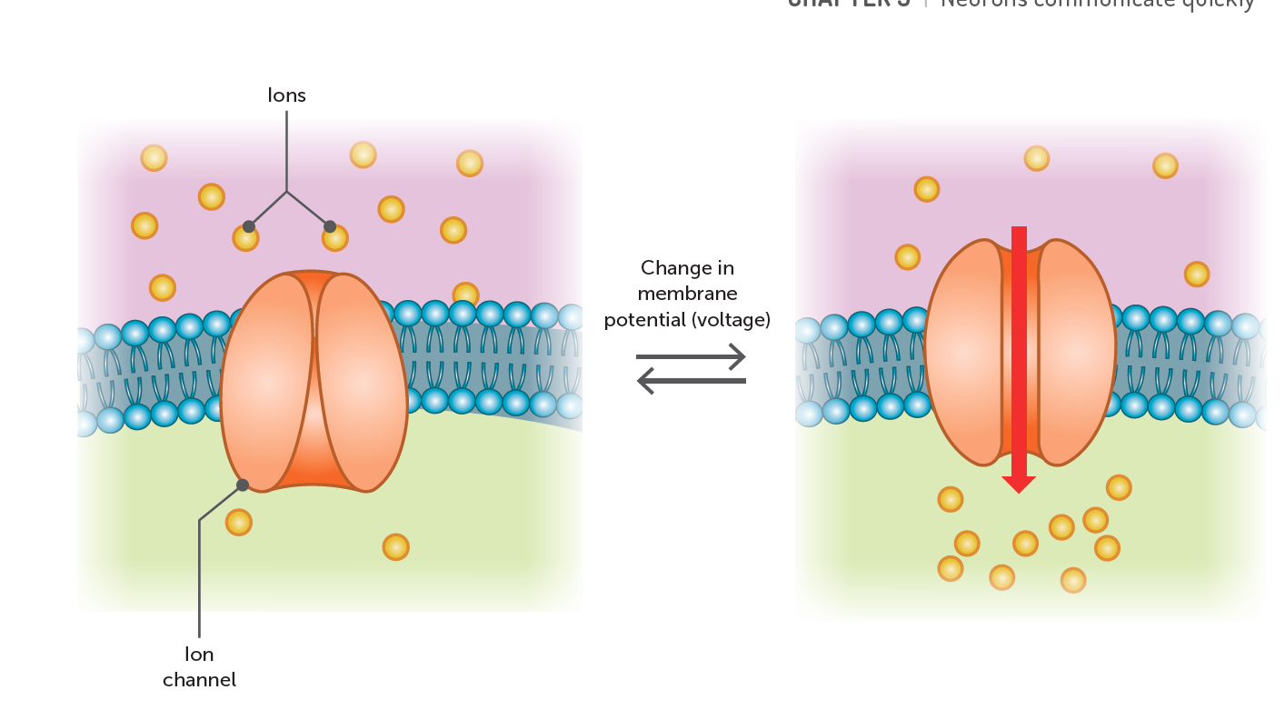
Nervous Impulses
Nervous impulses are the messages' sent from one part of the nervous system to another due to electrochemical change along the membrane of a nerve fibre. It is called an electrochemical change because a change in concentration of the ions inside and outside of the membrane induces a change the electrical voltage of the neuron.
Notes:
Teacher Cue – refer to the vocabulary box as you read through and “unpack” the definition provided. Use hand gestures to emphasise the ”2 or more”, “mixed” and “separated” parts of the definition.
Have students complete CFU 1 as a pair-share, then record these definitions & examples as notes (with diagrams) if desired.
CFU 2 – pair-share, then whiteboards for answers – call on non-volunteers.

Slide 5
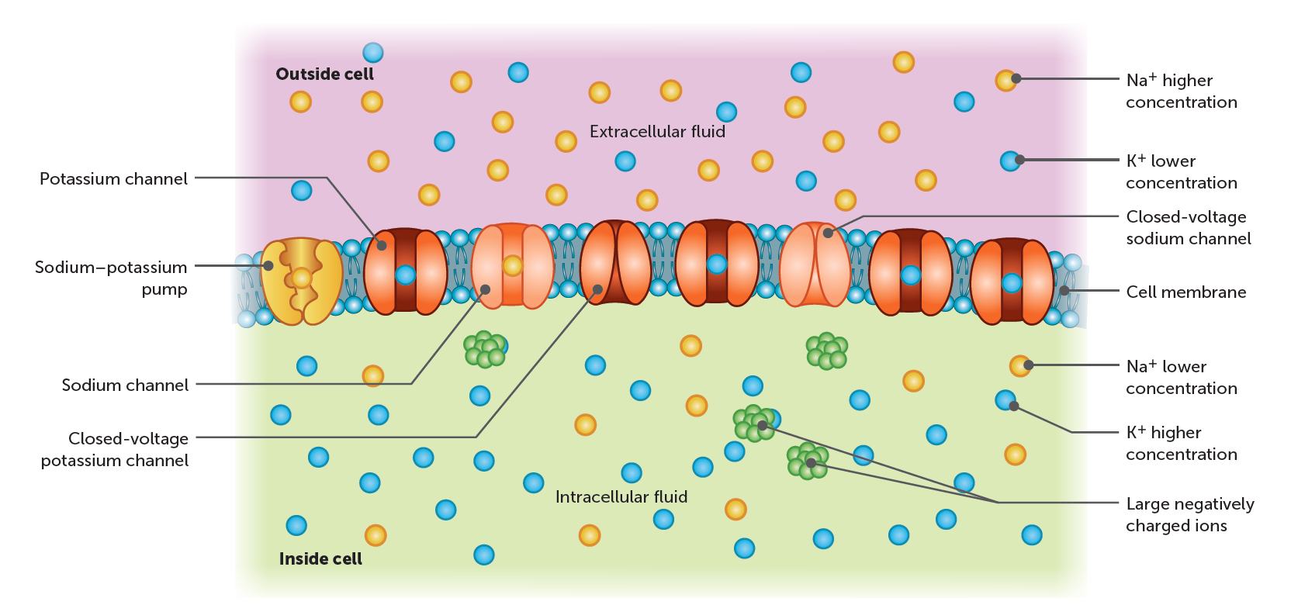
Nervous Impulses
Every neuron has what is called a resting membrane potential (= -70 mV) caused mainly by the differing concentrations of sodium and potassium ions inside and outside the membrane.
Extracellular fluid has a high concentration of Na⁺ and Cl⁻, and a low concentration of K⁺.
Intracellular fluid has a high concentration of K⁺ and negatively charged organic ions, but low concentrations of Na⁺.

Slide 6
Nervous Impulses
Because of the high levels of organic anions in the intracellular fluid, the positive charge of the potassium ions is insufficient to balance the negative charge and make the cell neutral, and hence the inside of the membrane is negative relative to the outside and can be classified as being polarised.

Slide 7
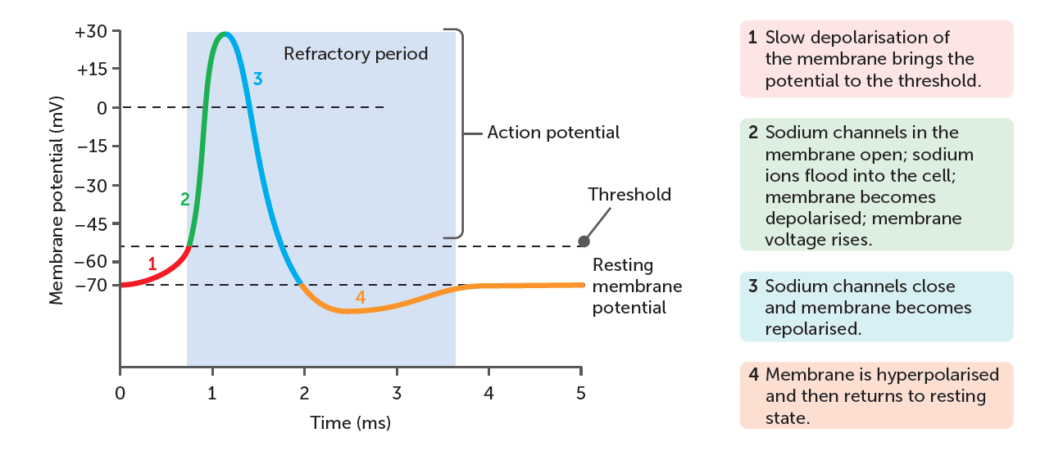
Transmission of impulses
The transmission of a nervous impulse along the length of a nerve fibre can be broken down into five steps:
1. Polarisation: at the resting potential, the membrane is polarised. As mentioned before, the inside of the cell contains mostly K⁺ ions and negatively charged organic molecules (net negative charge), while the outside is mostly made up of Na+ (net positive charge). A Na⁺/K⁺ pump (sodium/potassium pump) allows these ions to move across the membrane; sodium into the cell, and potassium out.

Slide 8
Transmission of impulses
2. Depolarisation: when a stimulus reaches the neuron, gated ion channels embedded in the membrane open, allowing sodium ions to quickly rush into the cell. This influx of positive charges rapidly depolarises the membrane.
KEY POINT: Depolarisation requires the stimulus to surpass a threshold level. If the stimulus exceeds the threshold, the channel will open, and sodium will rush into the cell (it does not matter how large to stimulus is; the same number of channels will open). If the stimulus does not exceed this threshold, nothing happens, and no impulse is transmitted.

Slide 9
Transmission of impulses
3. Repolarisation: when sodium ions flow into the cell, more gated ion channels open that allow potassium ions to flow out. The sodium channels close, and the membrane potential is restored as positive charge is able to leave the inside of the cell. This rapid depolarisation and repolarisation is called an action potential, and the movement of the action potential along the nerve fibre is the nervous impulse.

Slide 10
Transmission of impulses
4. Hyperpolarisation: when the potassium channels close, the cell has slightly more potassium ions on the outside of the membrane, than sodium ions inside the membrane, so the membrane potential is slightly more negative than the resting potential and the cell is said to be hyperpolarised.

Slide 11
Transmission of impulses
5. Refractory period: sodium and potassium are returned to their original positions by the Na⁺/K⁺ pump. While the neuron is busy restoring the ions to their original positions, it doesn't respond to any incoming stimuli and hence no nervous impulse is transmitted along that part of the fibre. The refractory period actually begins during the transmission of the action potential the fibre cannot respond to a stimulus while it is already responding to a different one.

Slide 12
The transmission of nervous impulses is different for unmyelinated and myelinated fibres.
Unmyelinated: Depolarisation of one area of the membrane causes the area adjacent to also depolarise, creating a 'domino effect that propagates the action potential along the fibre.
Myelinated: The myelin sheath insulates most of the membrane, separating it from the extracellular fluid. Hence, depolarisation can only occur at the Nodes of Ranvier (the gaps in the sheath) as they are the only areas that allow for ion exchanges between the intracellular and extracellular fluid, The action potential, therefore, jumps from one node to the next. A motion referred to as saltatory conduction. This means that impulses travel faster along myelinated fibres than unmyelinated.

Slide 13
Nerve Impulse
The impulse always travels away from the point of stimulus and is prevented from travelling backwards by the refractory periods of previous areas of the membrane. It is also important to note that the size of a nervous impulse along a fibre is always the same, as an identical action potential is generated when the threshold is crossed. It is possible to distinguish between a strong stimulus and a weak stimulus because:
A stronger stimulus will cause a greater number of nerve fibres to depolarise than a weak stimulus.
The number of nervous impulses generated in a given time will be greater for a stronger stimulus.

Slide 14
Nerve Impulse
KEY POINT: The diameter of a fibre changes the rate at which it transmits an impulse; the thicker the fibre, the faster the impulse.

